Slide 1
Jarvis Chatbot Final Analysis and Suggestions
by
Srivatsa Mallapragada, Nate Jones, Caleb Greski

Slide 2
Recap …

Slide 3
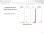
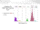
Summary from EDA
Average user usage of Jarvis using LUIS is better than Q&A as seen in users usage plot.
Intent classification for LUIS is better than Q&A as shown through confidence scores.

Slide 4
Final Analysis

Slide 5
Business Problem
How can we improve Jarvis for better user experience ?
Basing on our previous analysis between LUIS and QnA
Why to improve QnA for better user experience?
How can we improve JARVIS?

Slide 6
Why to improve QnA for better user experience?
What we did to answer the business question:
Average time underutilized due to repeated questions typed in JARVIS.
Grouped similar(99%) questions within an hour of each other as repeated questions.
Confidence scores for the grouped questions
Average time spent on each question.

Slide 7
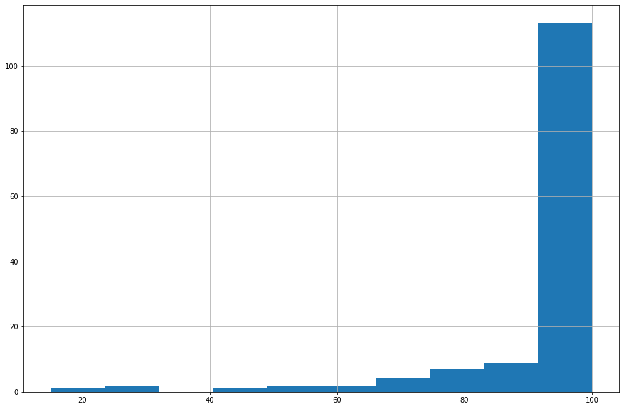
Why to improve QnA for better user experience?
Confidence scores on repeating questions for LUIS (Total Repeated Inputs = 141)
Mean score of 94%
More than 50% have 100% confidence scores
80% of repeated question are from People plugin (44)
9% are General plugin (1)
120
100
80
Count
60
40
20
20
40
60
80
100
Confidence Scores
Notes:
Maybe overlay total usage per year?

Slide 8
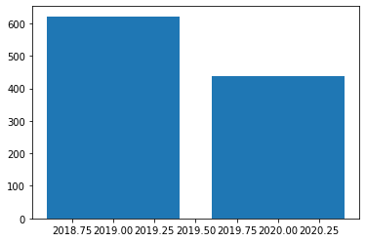
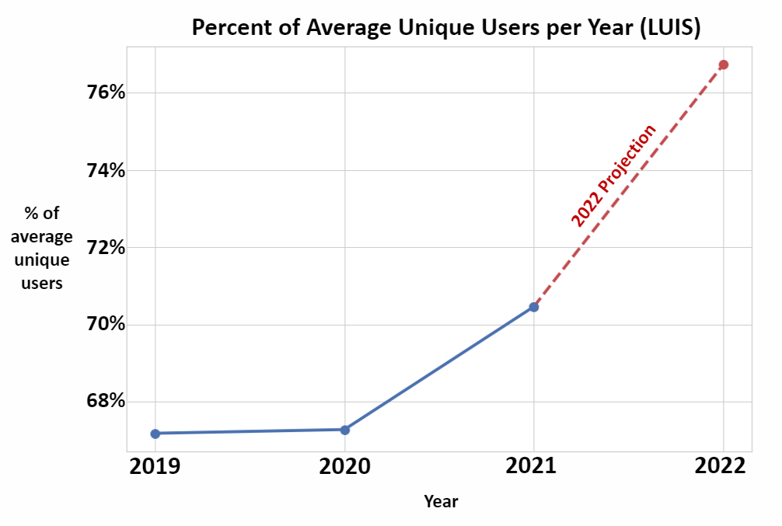
Why to improve QnA for better user experience?
Average minutes spent on repeating questions for LUIS (Total Repeated Inputs = 141)
10
8
6
Minutes
4
2
0
2019
2020
Year
Although unique users are increasing, the average time under-utilized is decreasing
Extrapolating time for each question:
7 min 18 sec in 2020 per question
111 x 7 min 18 sec = 810 min 18 sec (<14 hr)
No repeated questions in 2021, 2022
Notes:
Maybe overlay total usage per year?

Slide 9
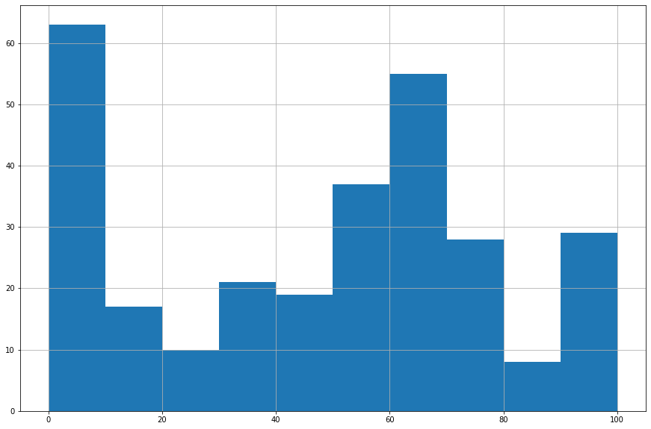
Why to improve QnA for better user experience?
Confidence Scores on repeating questions for QnA (Total Repeated Inputs = 287)
Mean confidence score of 46%
Around 50% have less than 50% confidence scores
72% of repeated questions are directed to Technology Service Center Plugin (2)
27% of the other questions are directed to General Plugin (1)
60
50
40
Count
30
20
10
0
20
40
60
80
100
Confidence Scores
Notes:
Maybe overlay total usage per year?

Slide 10
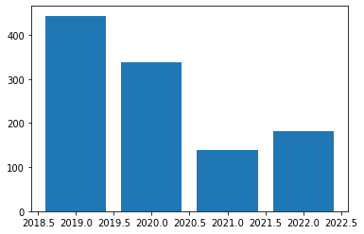
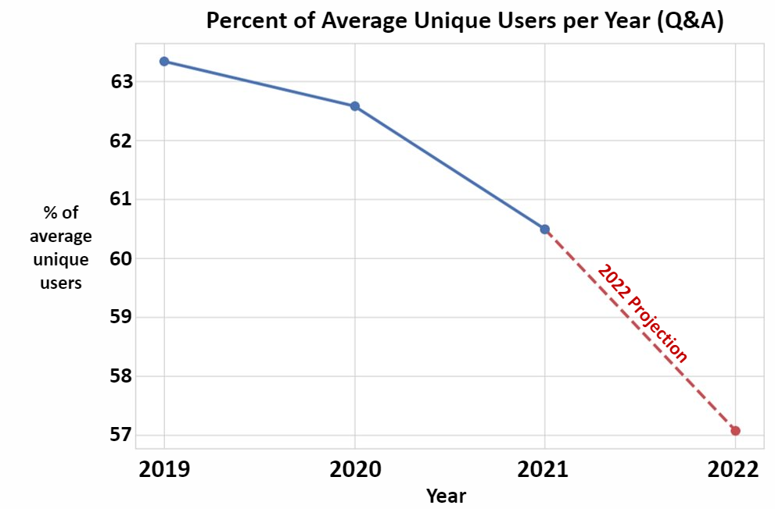
Why to improve QnA for better user experience?
Average minutes spent on repeating questions for QnA (Total Inputs = 287)
7
6
5
Minutes
4
Seconds
3
2
1
0
2019
2020
2021
2022
Year
Unique users are decreasing, the average time under-utilized is maintained or increasing
This trend is consistent when adding in more data
Extrapolating time for each question:
5 min 37 sec in 2020 per question
168 x 5 min 37 sec = 943 min 36 sec (<16 hr)
Repeated questions started to increase in 2022
Notes:
Maybe overlay total usage per year?

Slide 11
Why to improve QnA for better user experience?
Improving QnA:
can mitigate current under-utilized employee time.
can prevent the scaling of these issues.
Notes:
Maybe show % users asking questions repeatedly and tie in previous analysis regarding survival rate?

Slide 12
How can we improve JARVIS?
We created topics for user inputs, and plugin outputs using BERTopic [1]
Created topics based on user inputs and used it to label plugin outputs
Created a list of all non-similar topics between the two columns for each input

Slide 13
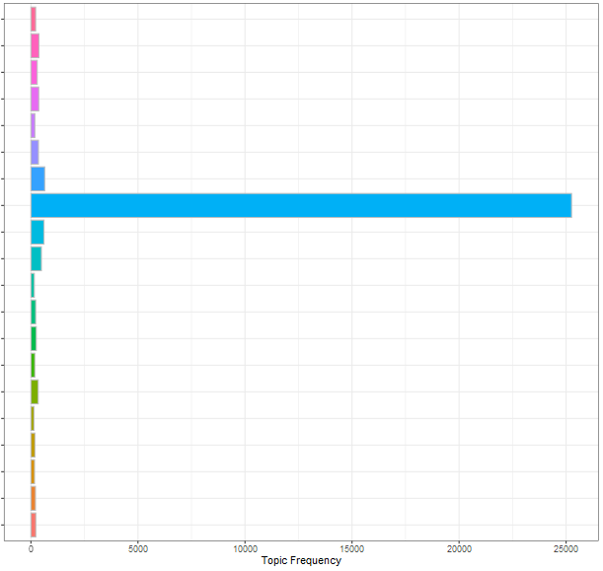
How can we improve JARVIS?
Total topics in user input
Token Requests
Titles
Most of the User Inputs are querying about PC Issues, Software Issues, or Contact Information
Teams
Software Application Install, Update, or Restart
Skype
Printing
Phone Contact Information
PC Issues and Requests
< 26K
Password Management
Outlook Access
OneDrive Access
Jarvis Functionality Testing
Intercompany Emails
Help Desk Contact
General PC
Actions and Downloads
General Outlook Usage
Digital Security
Department Contact
Compliance
Access Requests
Notes:
1.These are the topics generated from user inputs
2.PC issues and requests are most asked questions

Slide 14
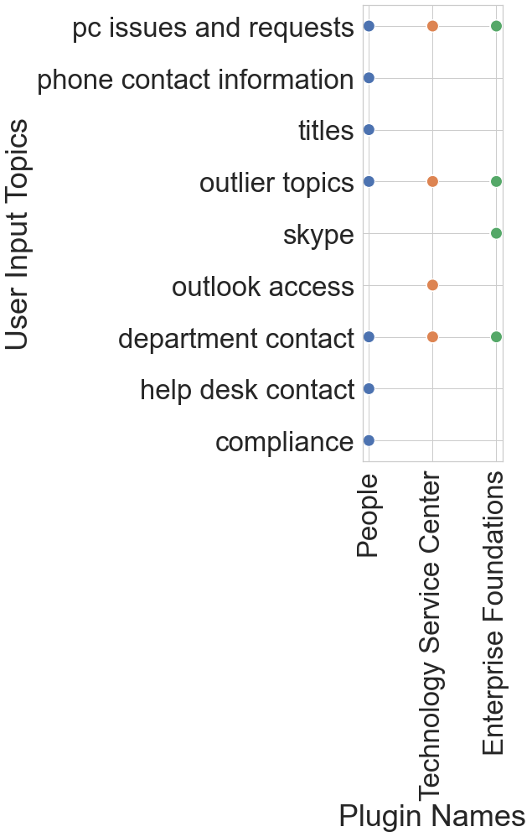
How can we improve JARVIS?
Common topics between user inputs and plugin response LUIS
(Total good responses = 4551)
Mean confidence scores for each plugin:
Enterprise Foundation = 98%
People = 99%
Technology Service Center = 93 %
LUIS classifies the user inputs to specific plugins only
Specific topics like phone contact information, titles, software access and installations are handled very well
Notes:
1. Top 90% above confidence score topics for user inputs and plugin names
2. The colors in the plots are plugin names

Slide 15
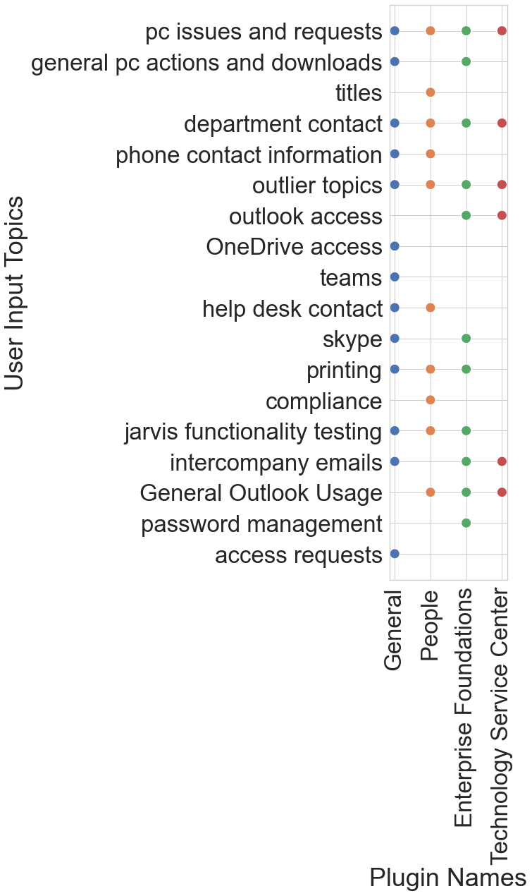
How can we improve JARVIS?
Uncommon topics between user inputs and plugin response LUIS
(Total bad responses = 2494)
Mean confidence scores for each plugin:
Enterprise Foundation = 56%
General = 43%
People = 72%
Technology Service Center = 76 %
LUIS lowest scores still separate and classify the user input to some plugin response
Notes:
1. The bad responses are uncommon topics between user input and plugin outs
2. LUIS tries the classify the user input to retrieve the relevant answer

Slide 16
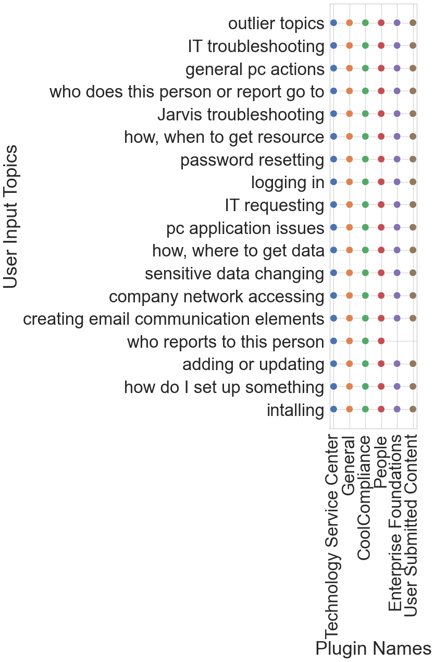
How can we improve JARVIS?
Uncommon topics between user inputs and plugin response QnA
(Total bad responses = 99266)
Mean confidence scores for each plugin:
Cool Compliance = 36%
Enterprise Foundation = 34%
General = 0%
People = 26%
Technology Service Center = 48 %
User Submitted Content = 26%
QnA gives responses from every plugin to every topic resulting in poor experience
Most specific IT, people topics are not being responded very well.
Notes:
1. Qna plugin outputs are addressing the user input from all the plugins

Slide 17
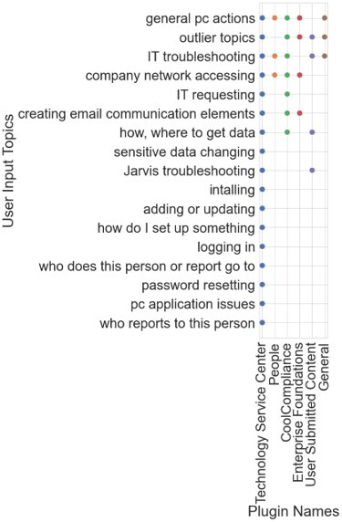
How can we improve JARVIS?
Common topics between user inputs and plugin response QnA
(Total good responses = 5792)
Mean confidence scores for each plugin:
Cool Compliance = 32%
Enterprise Foundation = 23%
General = 99%
People = 18%
Technology Service Center = 48 %
User Submitted Content = 27%
QnA give better responses for technology-based troubleshooting, email communications, updating, and installations.
These are already addressed by LUIS
Notes:
Communicate that QnA has low scores for the good responses.
To improve jarvis we need QnA and LUIS to work hand-n-hand to answer the questions.

Slide 18
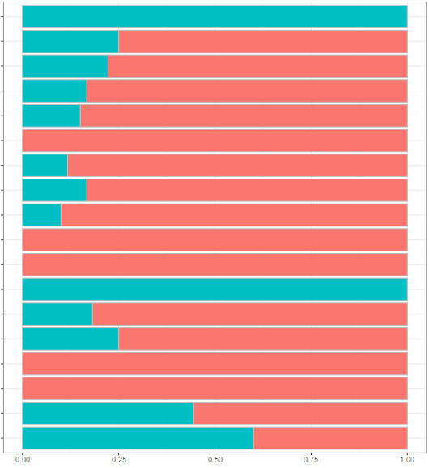
How can we improve JARVIS?
User Comments: Sentiment Analysis by User Input Topic (QnA)
Negative
Positive
Token Requests
Topics with
Positive Sentiment
Token Requests
Access Requests
Help Desk Contact
Teams
Software Application Install, Update, or Restart
Skype
Printing
Phone Contact Information
PC Issues and Requests
Topics with Negative Sentiment
Phone Contact Information
OneDrive access
Intercompany Emails
Digital Security
Department Contact
Password Management
Outlook Access
OneDrive Access
Intercompany Emails
Help Desk Contact
General PC Actions and Downloads
General Outlook Usage
Digital Security
Department Contact
Compliance
Access Requests

Slide 19
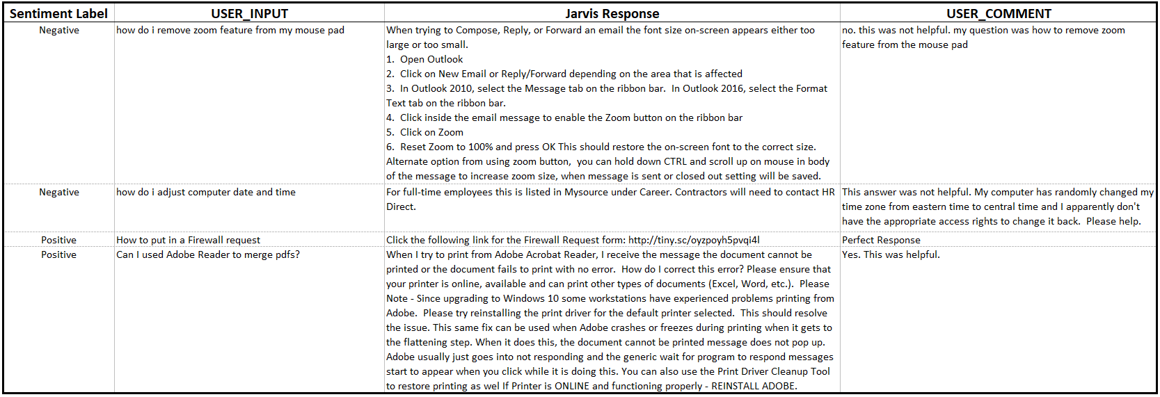
How can we improve JARVIS?
Topic Analysis: PC Issues and Requests (QnA)
PC Issues and Requests topic example:
88% of comments corresponding to this topic display negative sentiment.
Most helpful answers show a link or a contact form to the user input
Suggestion:
Show the link or form to contact respective department at the beginning of the answer to maximize the answer relevancy to the question like Google.

Slide 20
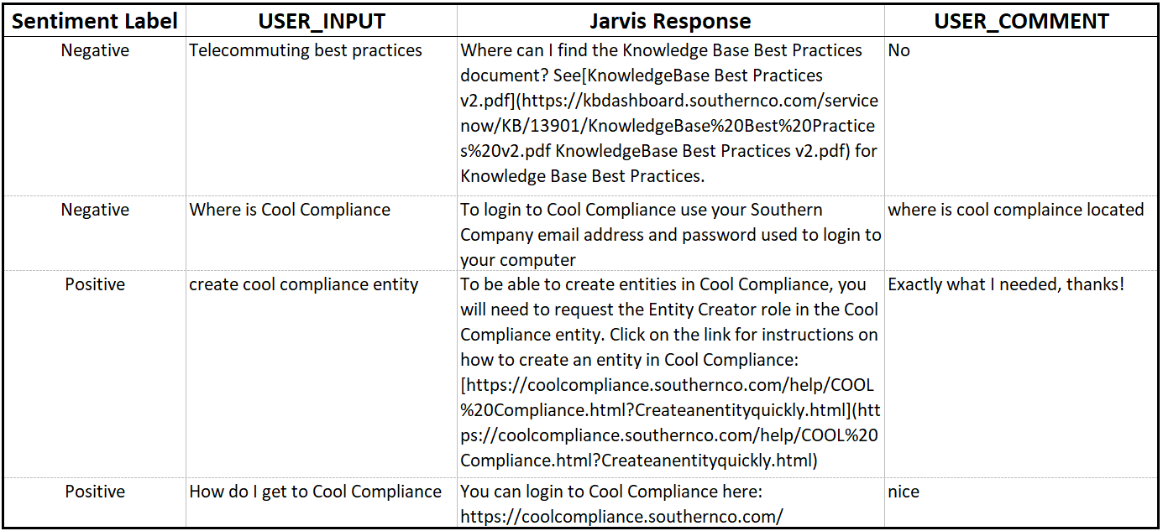
How can we improve JARVIS?
Topic Analysis: Compliance (QnA)
Compliance:
Questions are being answered but users are not always finding the answer helpful.
Suggestion:
Intent classification needs to be improved for better answers

Slide 21
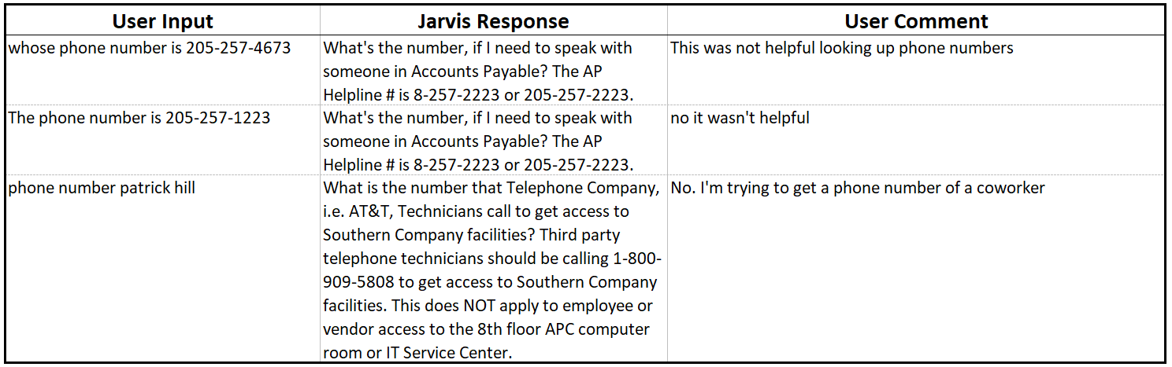
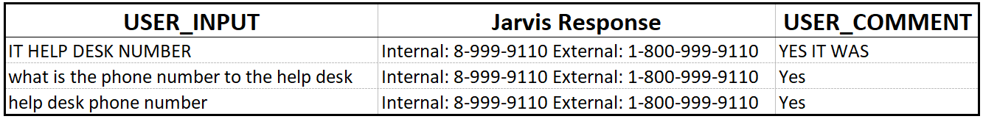
How can we improve JARVIS?
Topic Analysis: Phone Contact vs. Help Desk Information (QnA)
Phone Contact
Help Desk Information
Actionable Solutions:
SpaCy[2] could be used with a dictionary of Employees and their phone numbers to match employee-specific phone contact queries.

Slide 22
Summary
Why to improve QnA over LUIS:
Mitigate repeated questions which directly reduces the users' times for finding the right answers.
LUIS is good in responding to:
Employee Info
Installation Issues
LUIS can be improved on:
Specific Errors
Uninstallation
Access Issues
In future, we can improve LUIS for specific errors in Technology and People plugins.

Slide 23
Summary
QnA is good in responding to:
Token or Access Requests
Help Desk Contact
QnA can be improved by:
Show the link or form to contact respective department at the beginning of the answer to maximize the answer relevancy to the question like Google.
User intent classification for plugins which are not handled by LUIS.
Reducing the burst of responses.
Adding a SpaCy module to match employee names or phone numbers could aid employees searching for coworker contact information.
Increase relevant answers for the questions is also part of good classification intent.

Slide 24
Future
We want to build a demo classifier for Q&A for better intent classification:
Clustering or Topic Modeling
Text Classifier
Plausible Retrieval with Plugin Responses
"User input"
Labeling
Cluster the user inputs​
Label the clusters based on LUIS intent plugin ids​
Build a text classifier to predict Plugin ids from user input data​
Use Plugin responses from the data to manually evaluate a few final test samples

Slide 25
References
https://github.com/MaartenGr/BERTopic
https://spacy.io/usage/rule-based-matching

Slide 26
Questions ?

Slide 27
Thank you

Slide 29
Appendix

Slide 30
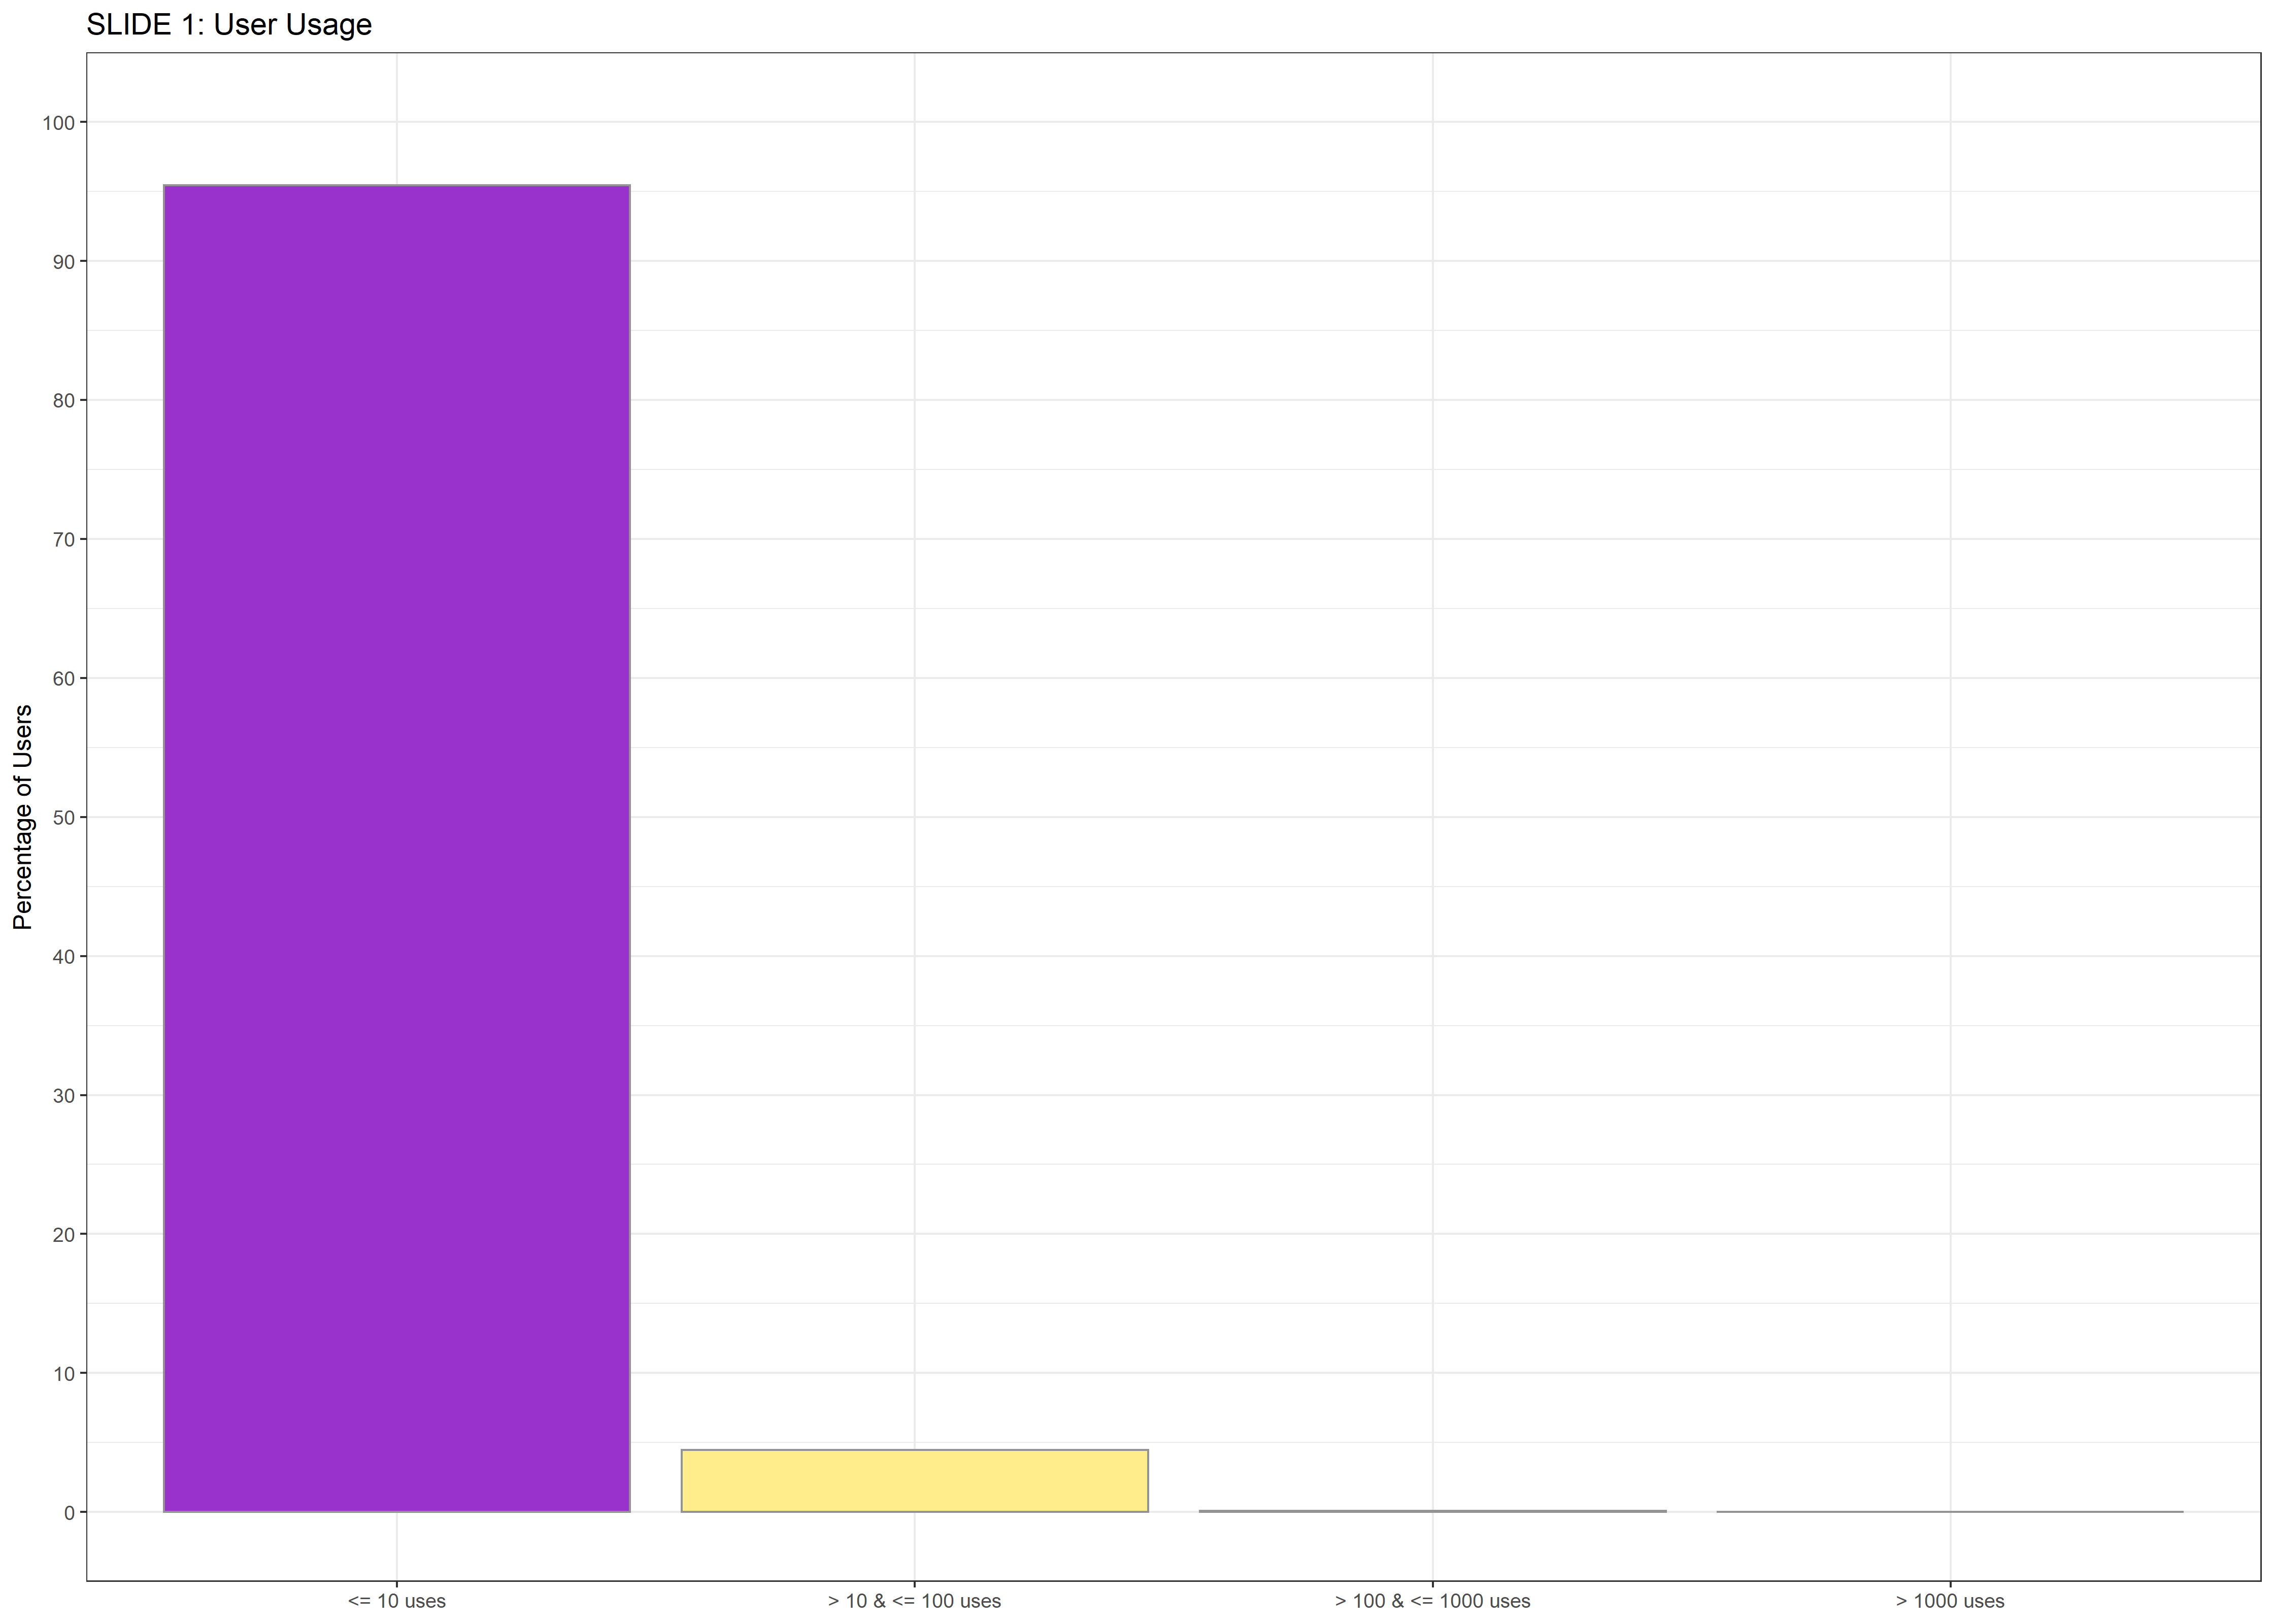
Users Usage
100
95.4%
4.5%
0.1%
0.01%
(User Count = 12,273)
80
Users grouped by usage
60
% of User
40
So, 95% of Users:
Used 1 to 10 times
20
0
1 to 10
10 to 100
100 to 1000
> 1000
Number of Times a User used Jarvis

Slide 31
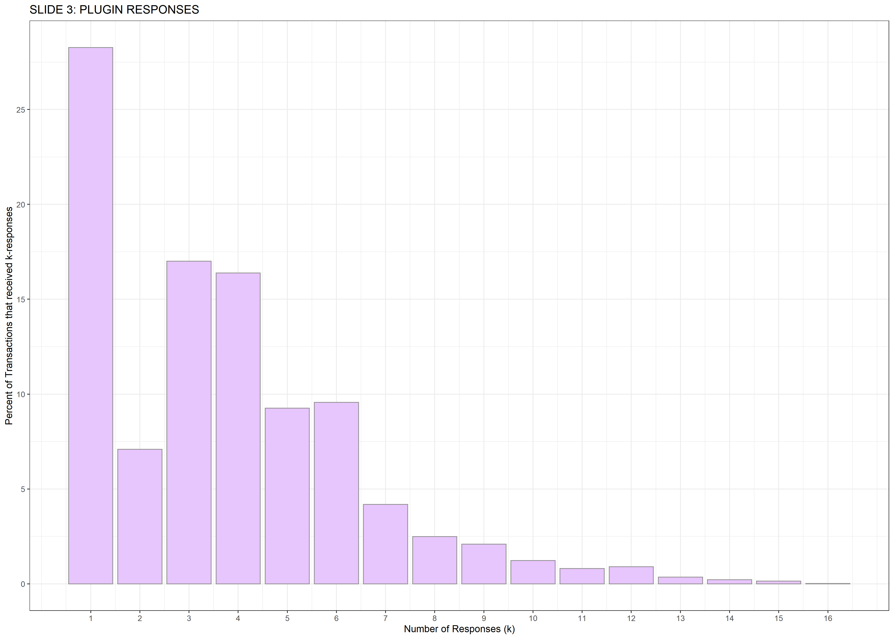
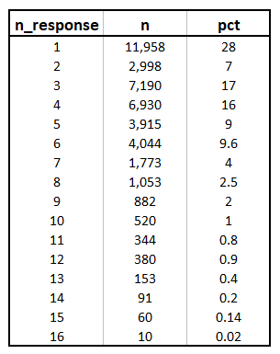
Plugin Responses
25
(Transaction Count = 42,301)
20
Users receive
1-16 responses
per transaction.
15
% of Transactions
10
5
0
1
2
3
4
5
6
7
8
9
10
11
12
13
14
15
16
Number of Responses Jarvis Returns

Slide 32
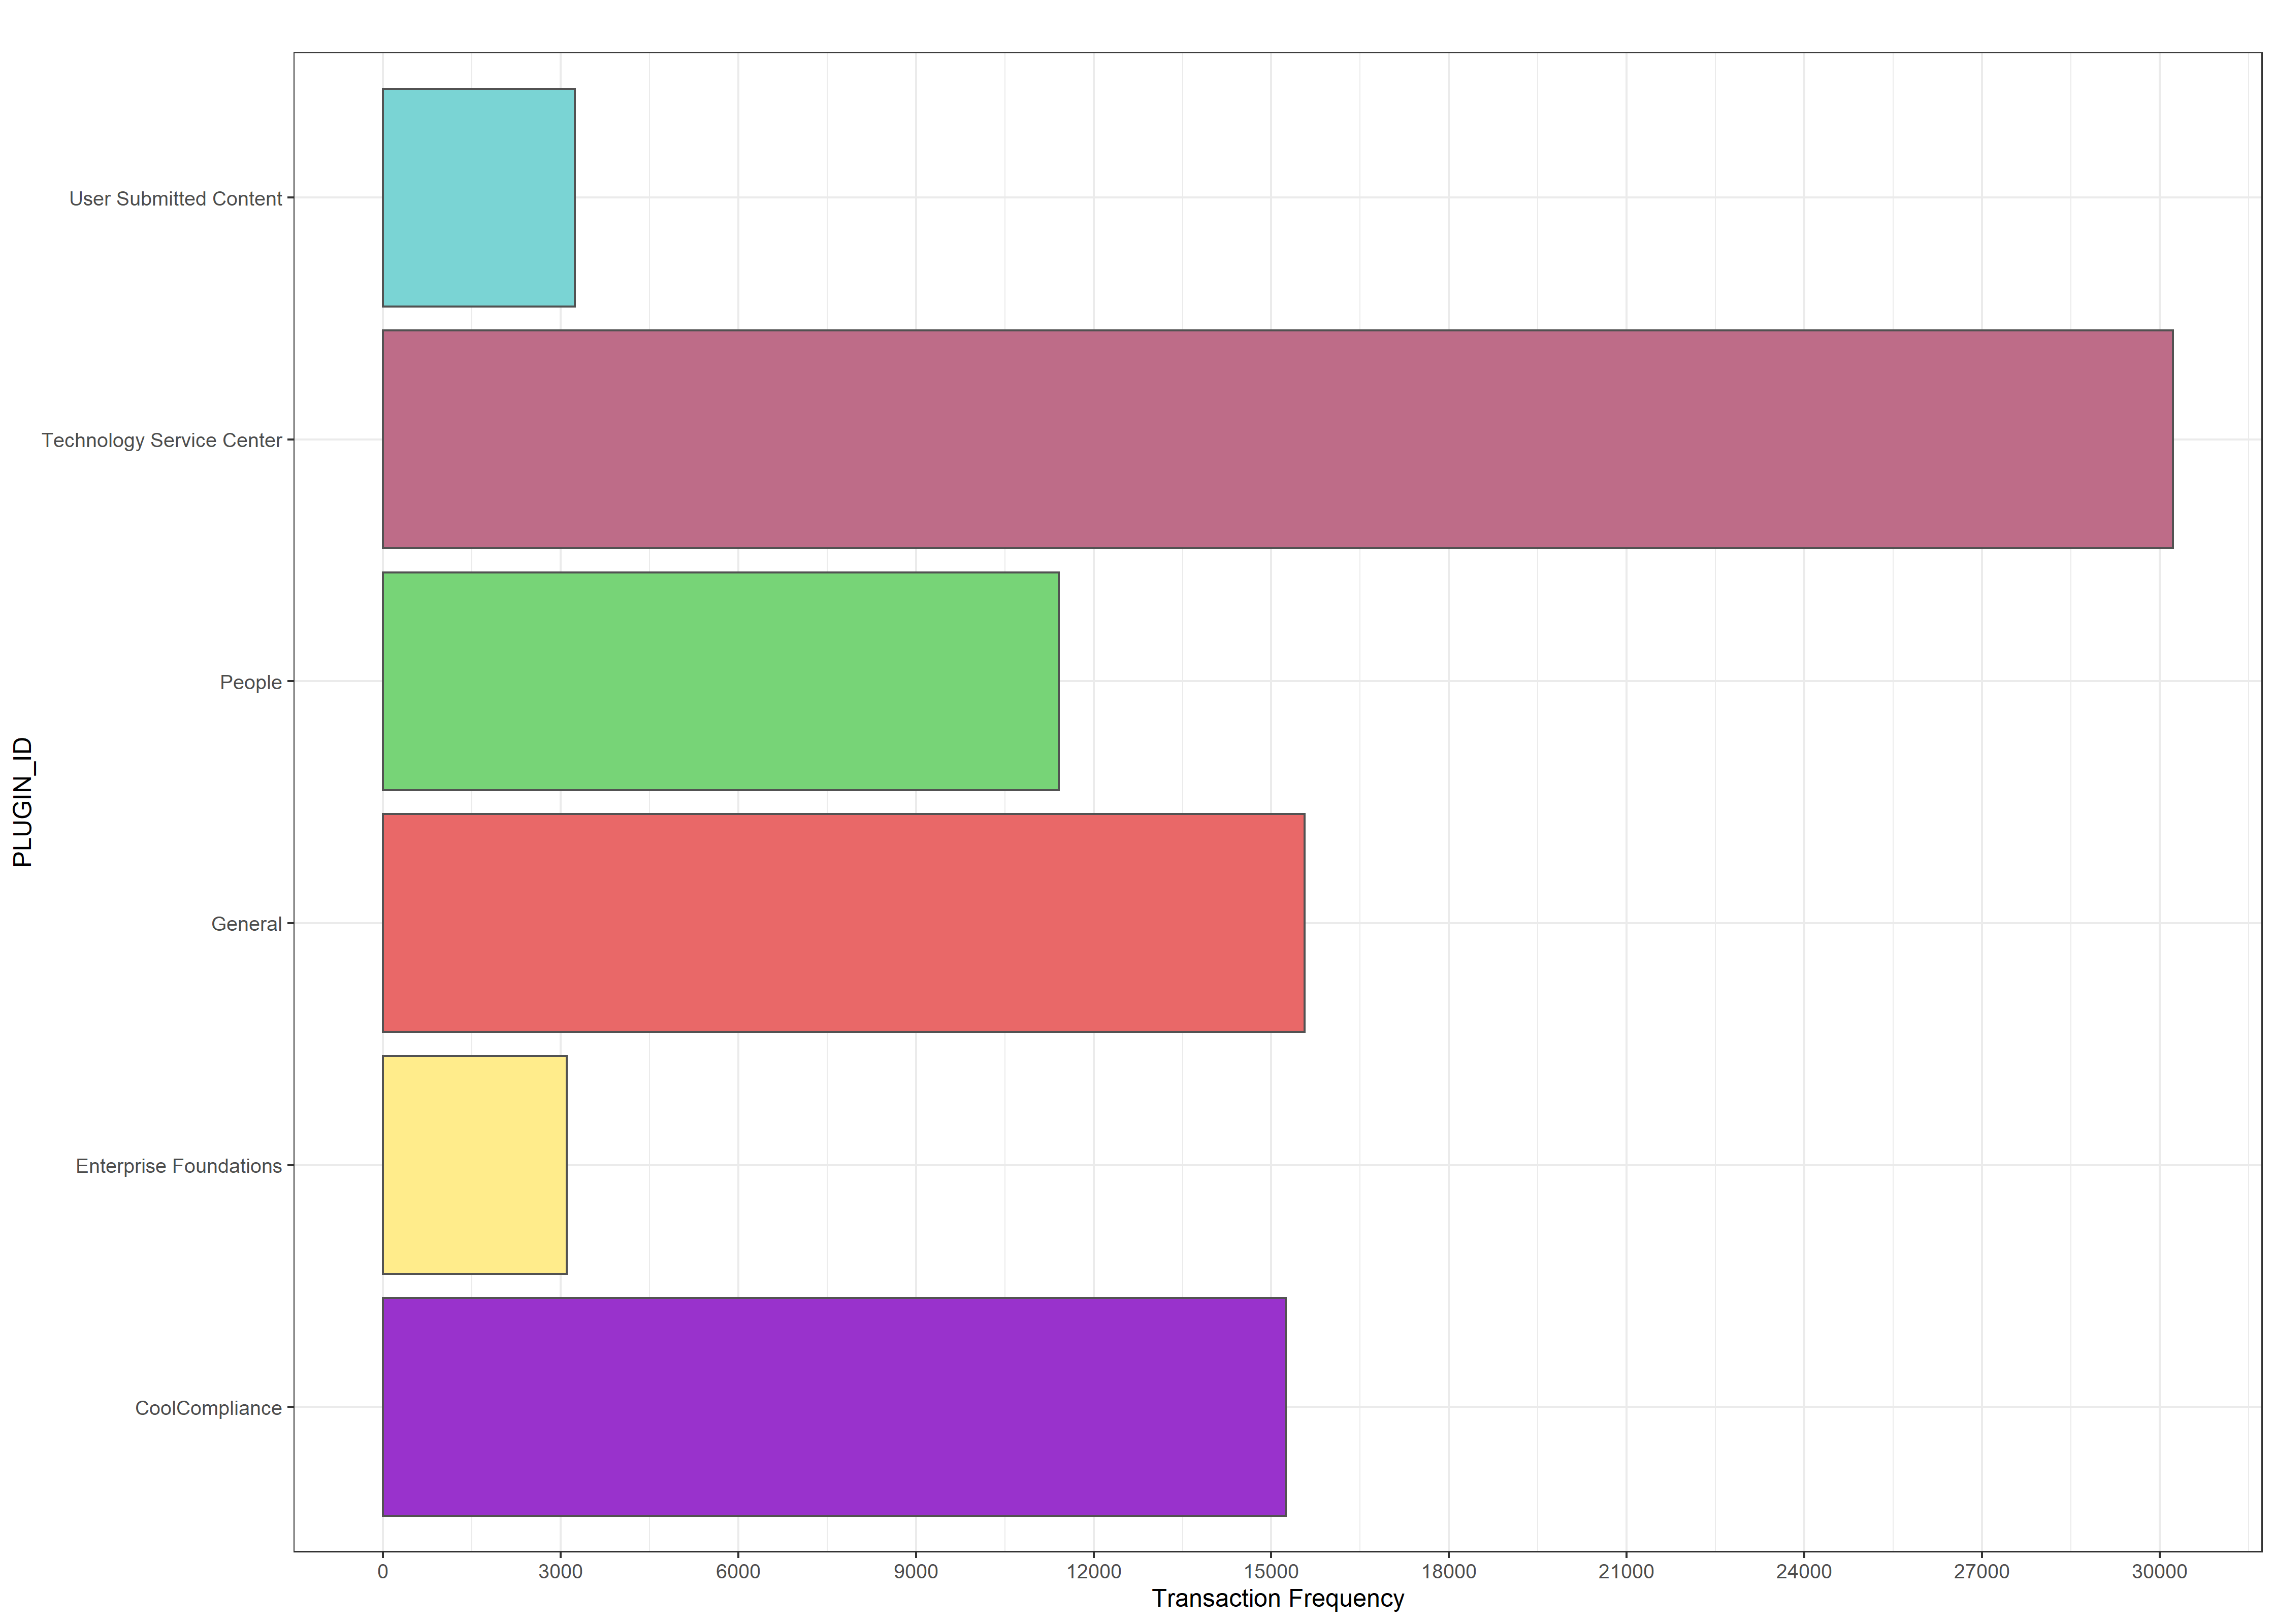
Plugin Frequency
User Submitted Content
8%
(Transaction Count = 42,301)
Technology Service Center
71%
71% of Transactions received at least one response from
Technology Service Center
People
27%
General
37%
Enterprise Foundations
7%
Is the number of responses affecting users?
Cool Compliance
36%
% of Transactions (Transaction Count = 42,301)
Notes:
The plugin "People" has many Scores at 100. These are queries regarding simple information like Employee Information. It appears that the chatbot may be recognizing this question but not outputting an answer that is helpful to the user.
Note from Caleb: The recognized intent outputs are when the bot initiates a LUIS interactive module, so the answer is indeed helpful. (I.e. pulling up an interactive employee database)

Slide 33
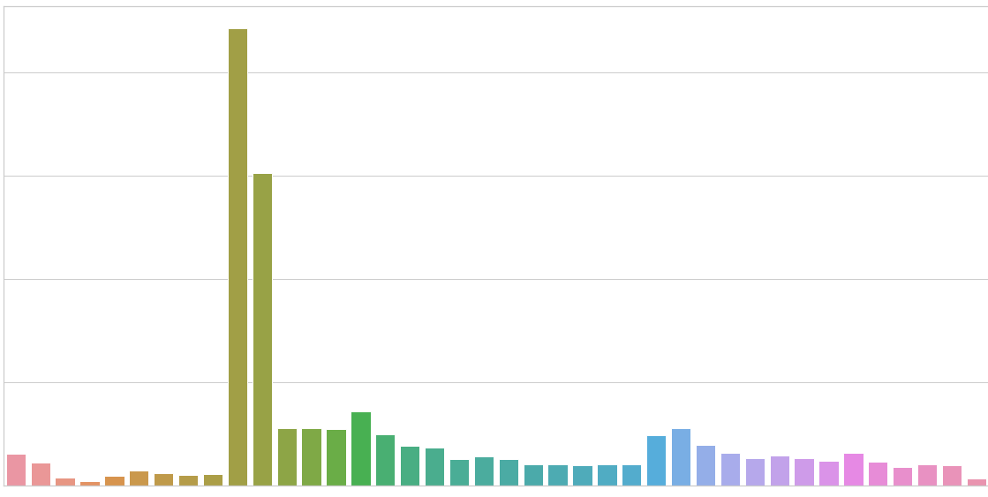
Frequency of Unique Users per Month-Year (LUIS)
800
The number of average unique users increased slightly for each month for LUIS.
400
0
10
11
5
6
7
8
9
12
1
2
3
4
5
6
1
2
3
4
5
6
12
12
5
7
8
9
11
1
10
7
8
9
2019
2020
10
11
2
3
4
6
7
8
2021
2022
Month-Year
Notes:
The plugin "People" has many Scores at 100. These are queries regarding simple information like Employee Information. It appears that the chatbot may be recognizing this question but not outputting an answer that is helpful to the user.

Slide 34
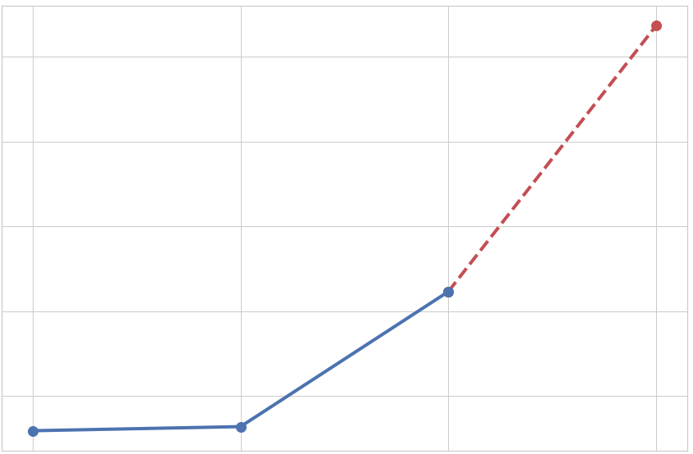
Percent of Average Unique Users per Year (LUIS)
76%
Average unique users
increased by year
for LUIS responses.
74%
2022 Projection
% of average unique users
72%
70%
68%
2019
2020
2021
2022
Year
Notes:
The plugin "People" has many Scores at 100. These are queries regarding simple information like Employee Information. It appears that the chatbot may be recognizing this question but not outputting an answer that is helpful to the user.
Users' usage can
increase
if their responses
are handled by
LUIS

Slide 35
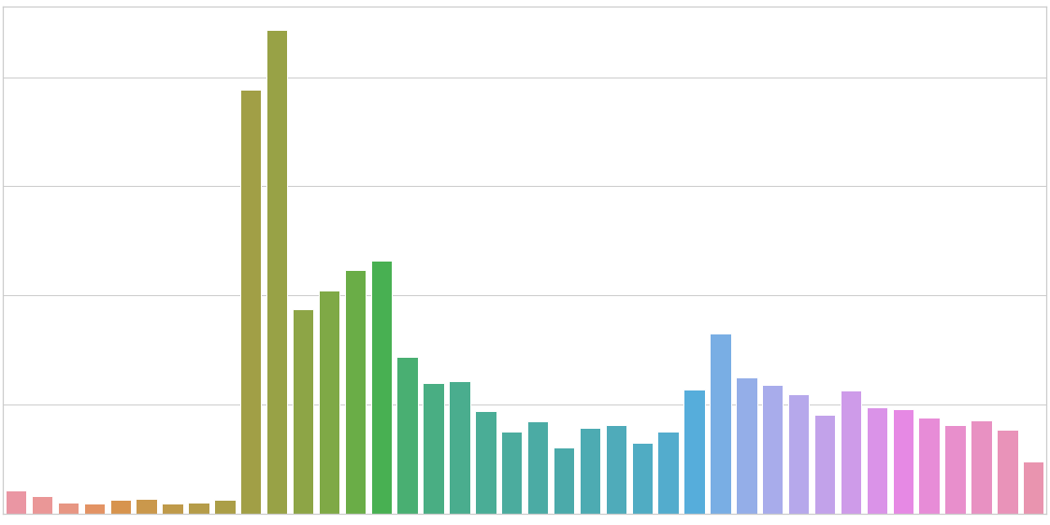
Frequency of Unique Users per Month-Year (Q&A)
2000
1000
The number of Unique users decreased
each month
for Q&A.
0
8
10
4
5
6
9
11
1
2
3
4
6
12
1
12
5
12
5
7
8
9
11
1
10
7
8
9
5
6
7
2
3
10
11
2
3
4
6
7
8
2019
2020
2021
2022
Month-Year
Notes:
The plugin "People" has many Scores at 100. These are queries regarding simple information like Employee Information. It appears that the chatbot may be recognizing this question but not outputting an answer that is helpful to the user.

Slide 36
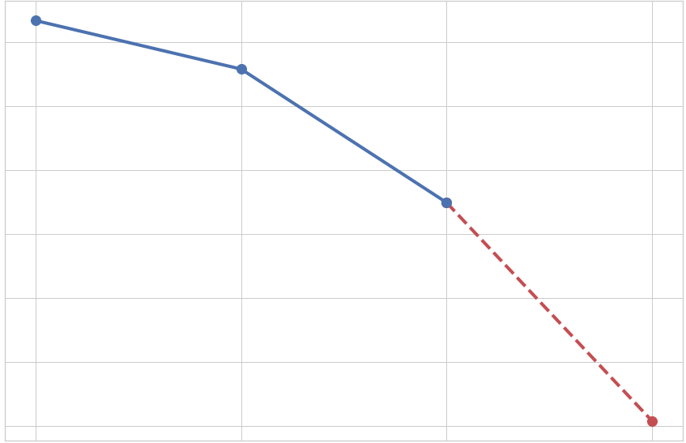
Percent of Average Unique Users per Year (Q&A)
63
62
61
% of average unique users
60
59
2022 Projection
Average unique users decrease by year for Q&A responses
58
57
2019
2020
2021
2022
Year
Notes:
The plugin "People" has many Scores at 100. These are queries regarding simple information like Employee Information. It appears that the chatbot may be recognizing this question but not outputting an answer that is helpful to the user.

Slide 37
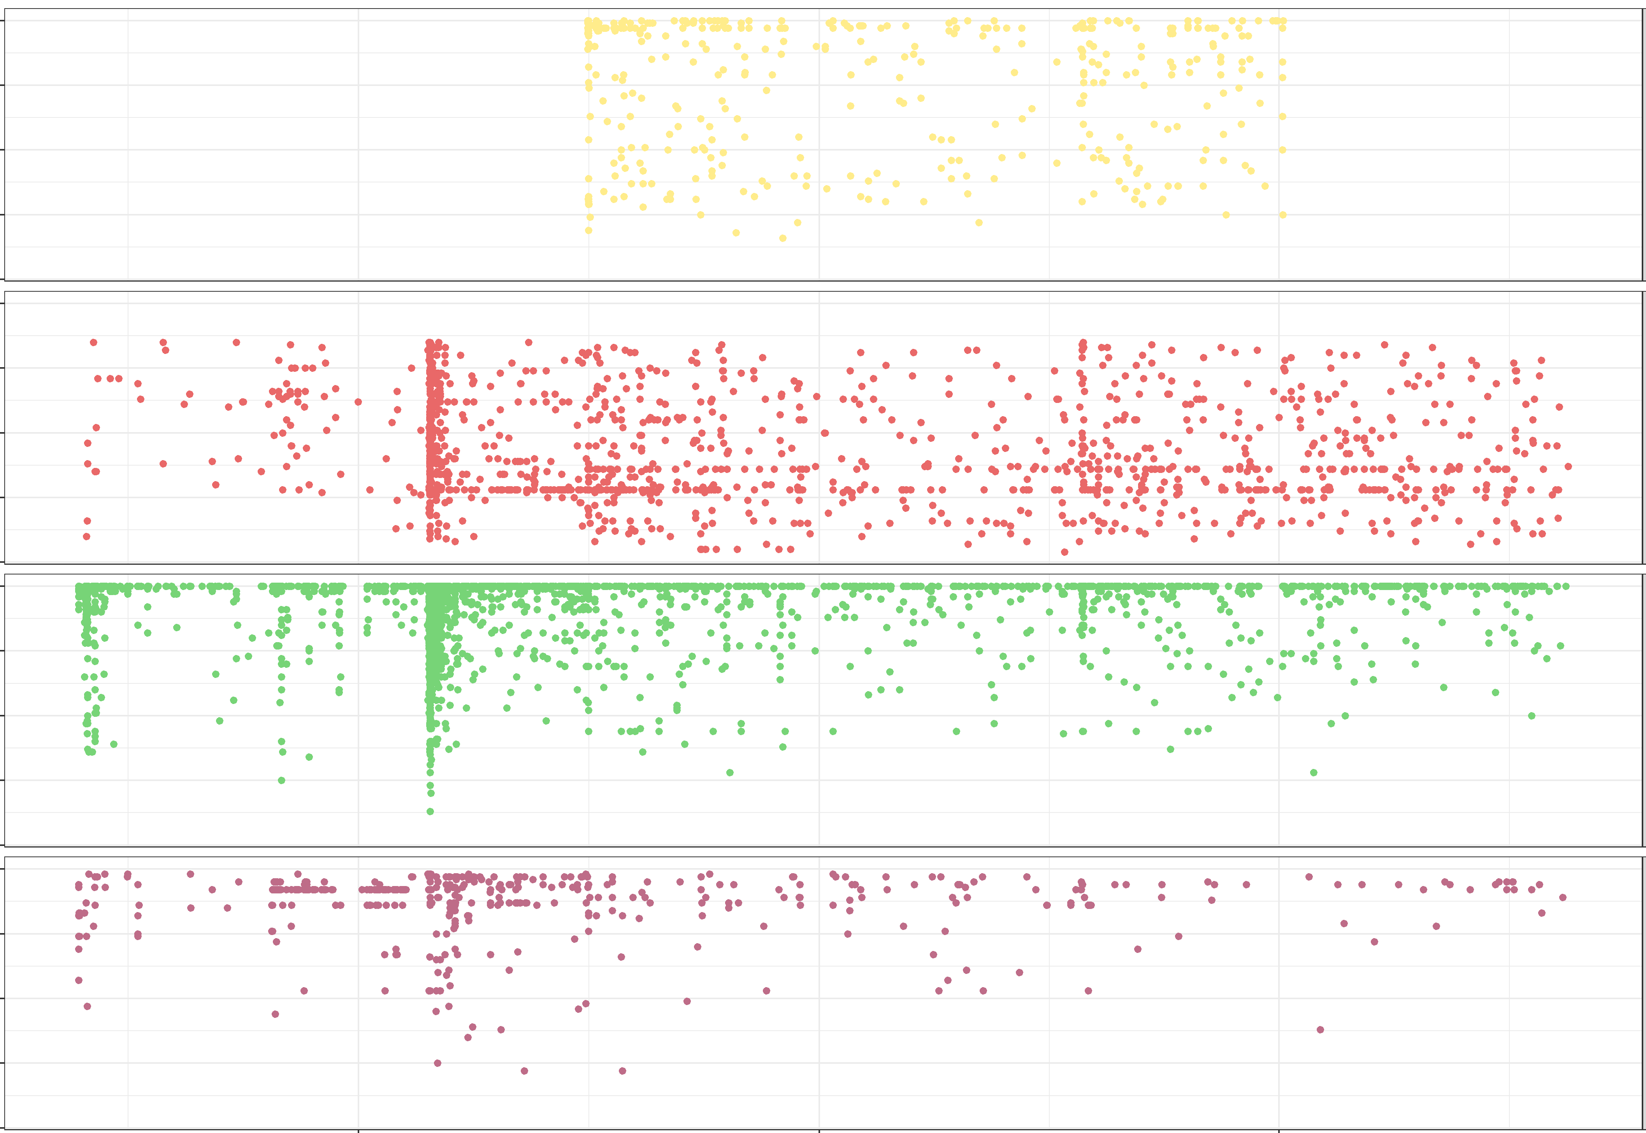
Plugin Response Score by Transaction Time Point (LUIS)
100
75
Enterprise Foundations
50
25
0
General
Plugin Response Score
100
75
50
People
25
Clear trends in score over time
0
Technology Service Center
2019
2020
2021
2022
Transaction Time Point

Slide 38
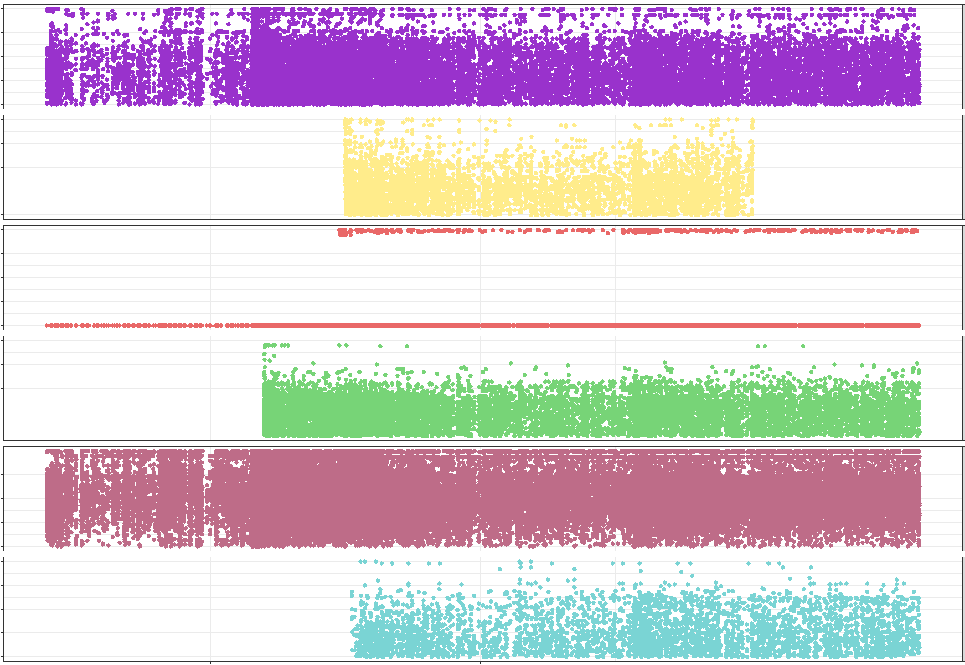
Plugin Response Score by Transaction Time Point (Q&A)
100
50
Cool Compliance
0
Enterprise Foundations
100
Plugin Response Score
50
General
0
Very Noisy
Trends with lower average scores
People
100
50
Technology Service Center
0
User Submitted Content
2019
2020
2021
2022
Transaction Time Point

Slide 39
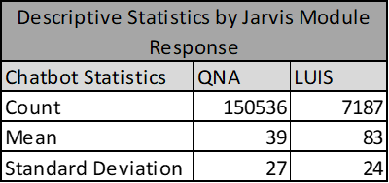
LUIS Performance
Q&A replies more, but LUIS is more confident
Notes:
Update Descriptive Stats to be Mean Standard Deviation and Median

Slide 40
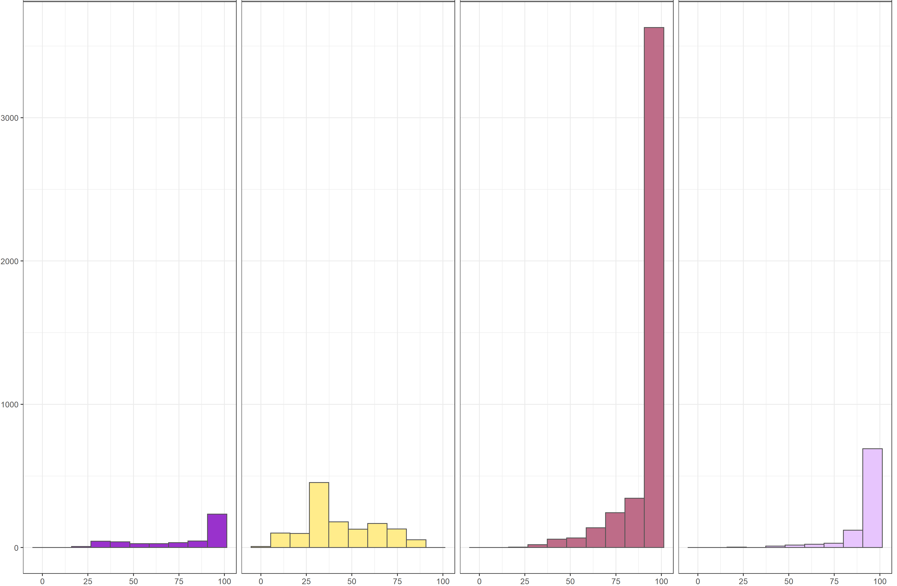
Histogram for LUIS Plugin Response Score
Enterprise Foundations
General
People
Technology Service Center
LUIS provides high scores
Plugin Response Score

Slide 41
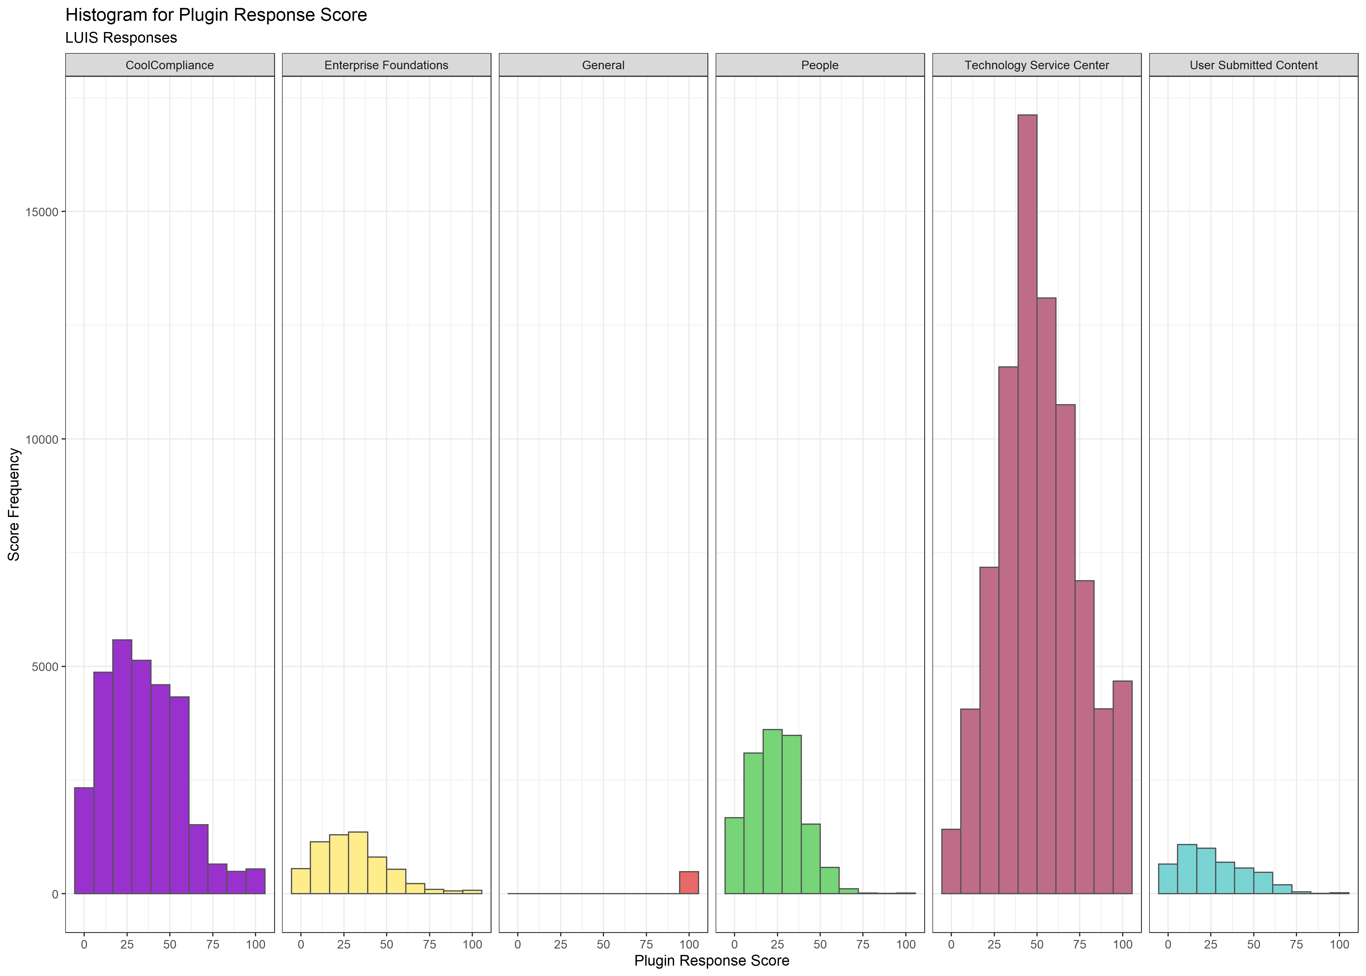
Histogram for QNA Plugin Response Score
Cool Compliance
Enterprise Foundations
Technology Service Center
User Submitted Content
General
People
QNA responses lower on average
Plugin Response Score
Notes:
100 Score for General is in response to either clear conversation questions like "how are you" or questions for how to get rid of Jarvis
100s overall are related to well worded questions like "how do I reset my password

Slide 42
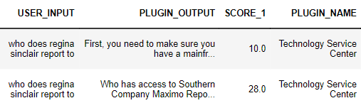
LUIS is Relevant
When a LUIS module is developed, it provides high confidence responses that are relevant to the request
Q&A
LUIS
LUIS intent classification shows higher correlation with confidence scores than Q&A
Notes:
Examples of user comments for these types of questions and maybe more examples in appendix

Slide 43
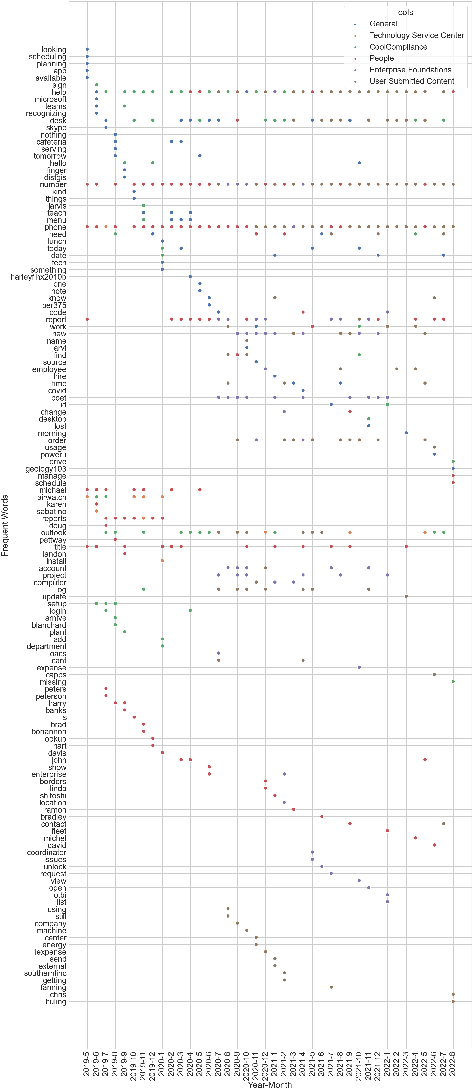
Time based user's input for LUIS
Most users were asking for "desk phone number" and were well classified and responded by LUIS module
Frequent words from user input
2019
2020
2021
2022
Year

Slide 44
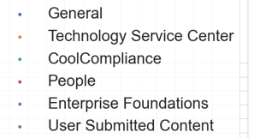
Time based user's input for LUIS
"report" in LUIS typically responded with a mean confidence score of 91
Frequent words from user input
"outlook" issues were one of the most often requests.
2019
2020
2021
2022
Year

Slide 45
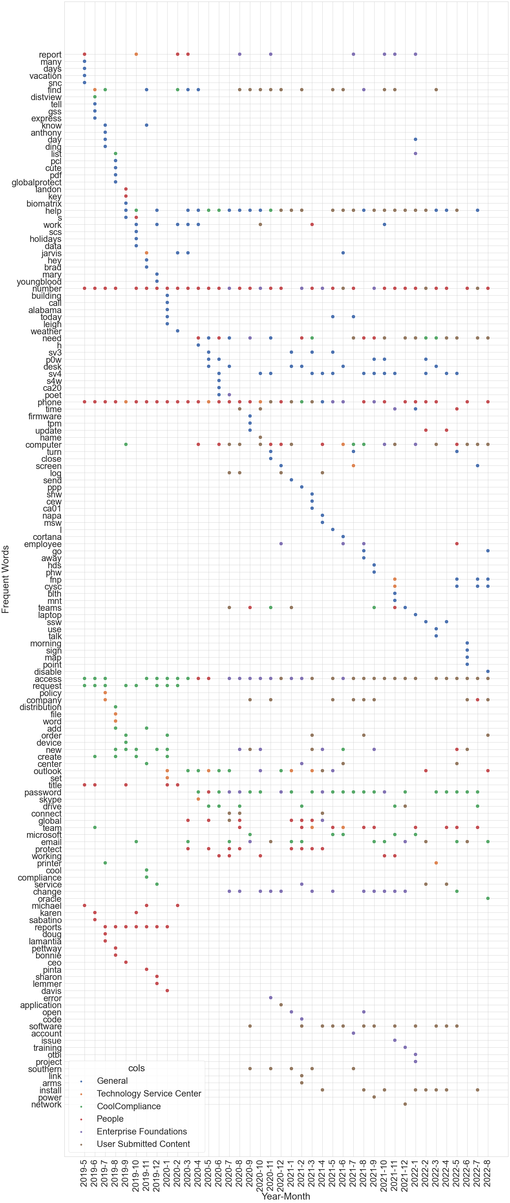
Time based user's input for Q&A
"report" questions were responded with mean confidence scores of 28
Frequent words from user input
find, help, phone, number" are the most frequent words for Q&A, but LUIS can handle it better
2019
2020
2021
2022
Year

Slide 46
Time based user's input for Q&A
"access, password" are important frequent words for Q&A and LUIS is less confident in responding for those questions
Frequent words from user input
2019
2020
2021
2022
Year

Slide 47
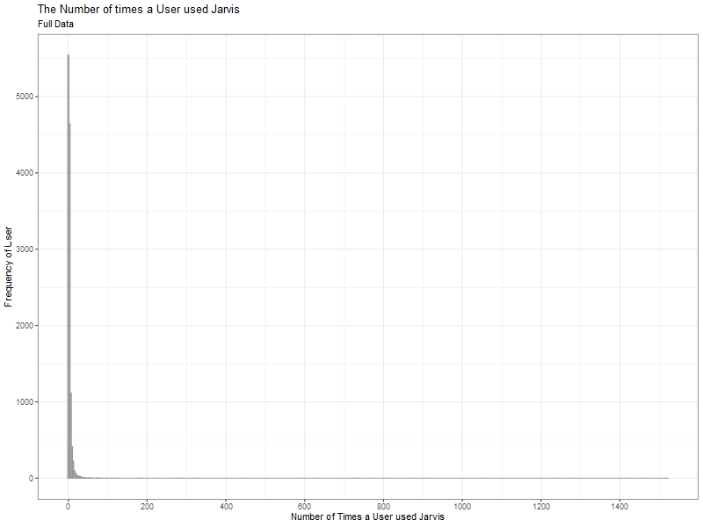
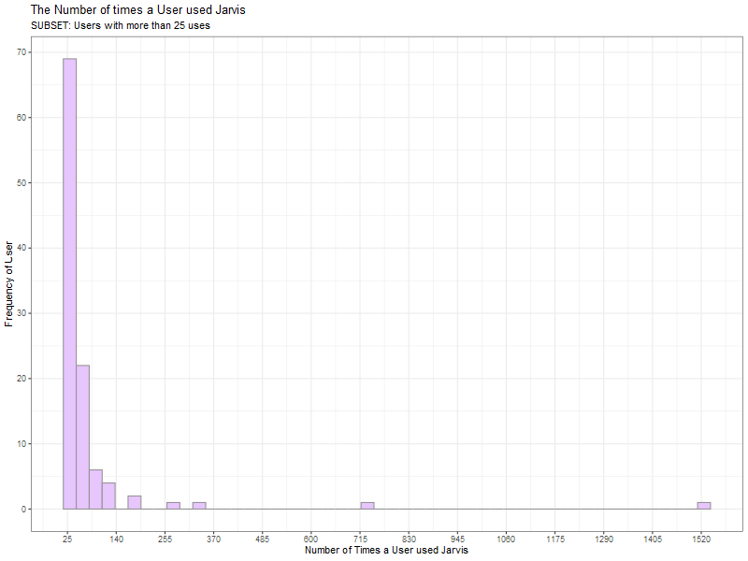
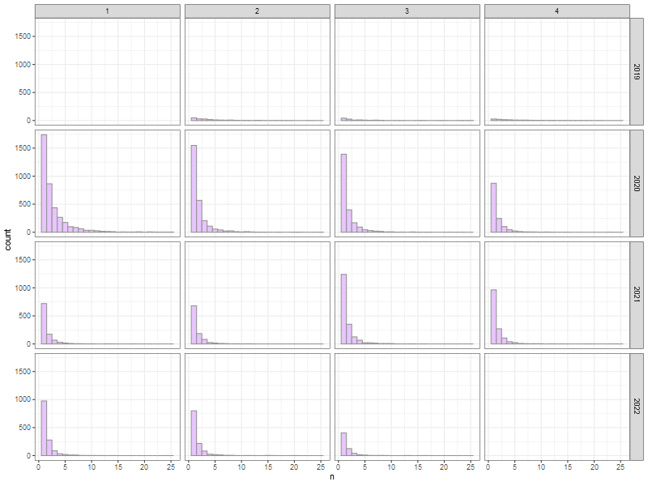
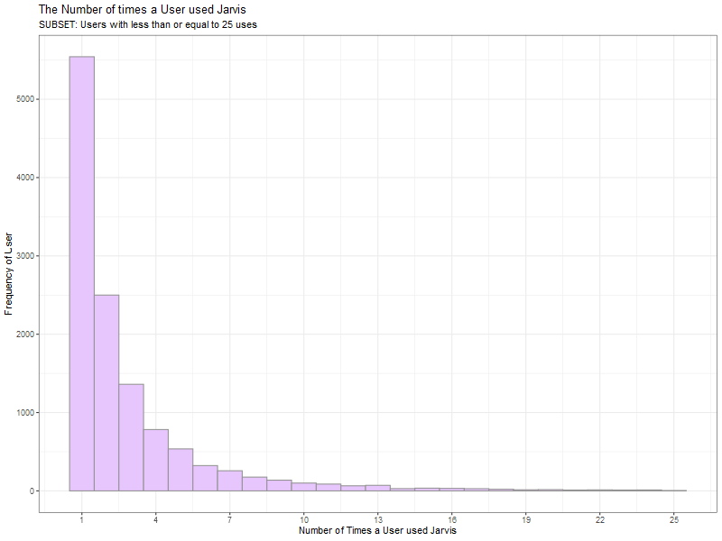
User Usage
Users with ≤ 25 Transactions
Full Data
Users with ≤ 25 Transactions
Users with > 25 Transactions
Q1
Q2
Q3
Q4
2019
Some users interacted with Jarvis a lot.
2020
User Frequency
Most users interacted with Jarvis 25 or less.
User Frequency
Peak-Usage: Q1 - 2020
2021
Notable Peak: Q3 - 2021
2022
Number of Times a User used Jarvis
Number of Times a User used Jarvis

Slide 48
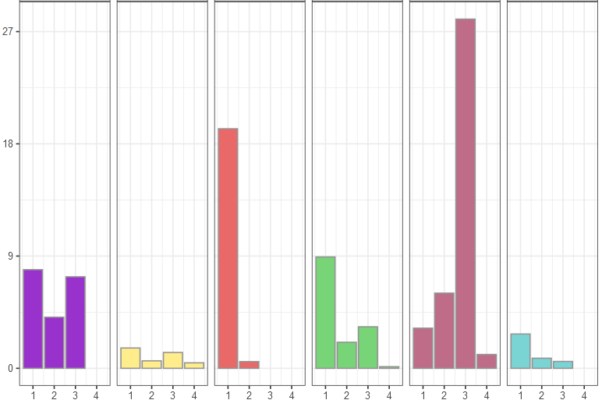
Plugin Responses
Enterprise Foundations
Technology Service Center
User Submitted Content
Cool Compliance
General
People
Total Transaction Count - 42,301 transactions
% of Transactions
Max Number of Responses Given
- 4
Number of Responses Given by Jarvis

Slide 49
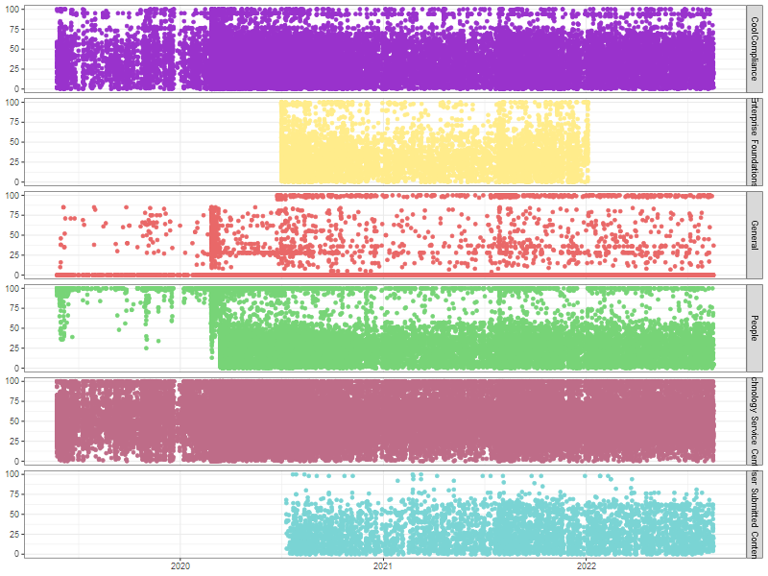
Plugin Response Score by Transaction Time Point
Cool Compliance
Very Noisy
Enterprise Foundations
Cluster at Q2 - 2020
Plugin Response Score
General
People Stalactites
People
Technology Service Center
User Submitted Content
Transaction Time Point

Slide 50
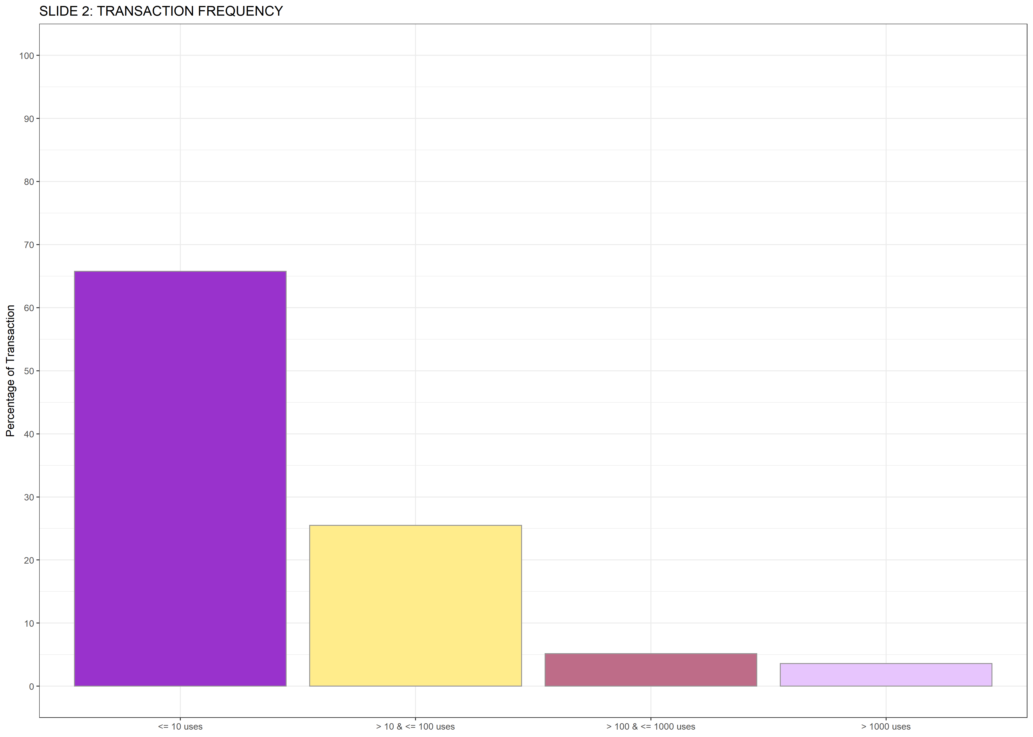
Transaction Frequency
65%
26%
5%
4%
100
(Transaction Count = 42,301)
80
Users grouped by usage
60
% of Transactions
So 95% of Users:
Used 1 to 10 times
40
20
65% of Transactions.
0
1 to 10
10 to 100
100 to 1000
> 1000
Number of Times a User used Jarvis

Slide 51
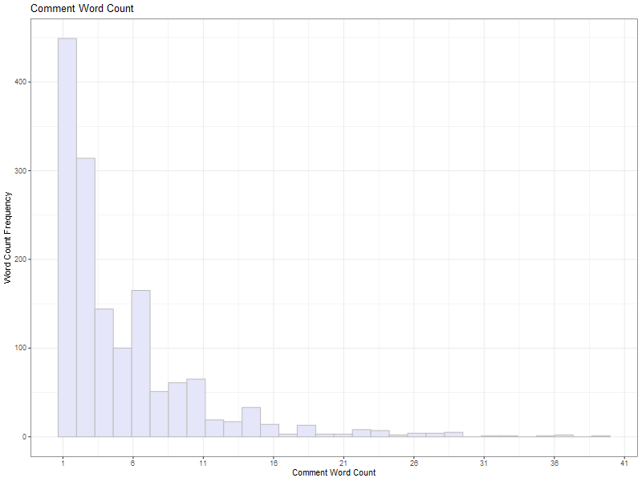
How can we improve JARVIS?
User Comments: Word Frequency for QnA
Most comments contained less than 10 words.
429 were only one word.
80% comments were 'No', 'Nope', or 'Unhelpful'.
20% comments were 'Yes', 'Perfect', 'Thanks', or ‘Helpful'
Word Count Frequency
Comment Word Count

